Slide 1
RFT for clinical use
Niklas Törneke, Yvonne Barnes–Holmes & Carmen Luciano

Slide 2
The structure of the workshop
Theoretical introduction
Metaphor
Experiential exercises
Notes:
Our aim: practical clinical talk, informed by theory

Slide 3
Functional Contextualism
CONTEXT
CONTEXT
Notes:
Going back to Skinner: What is the object of our analysis?? Someone acting!! Influence!!
Context has function (influences) behavior.
We are looking for functional relations in order to influence
Stimulus function! Operant, respondent.
Languaging is also contextual influence. Show how AARR works. AARR changes how we interact with our environment!!

Slide 4
Two areas of special interest
Complex verbal regulation (rule governed behavior)
Interaction with your own behavior

Slide 5
Complex verbal regulation
CONTEXT
A
C
CONTEXT
Notes:
Back to a particular interaction with context: the operant contingency. Compare with pigeons. “Red is green”. “That’s the best beer I ever had” “Something white in your beer”.
Antecedents can obtain stimulus function that will specify behavior and consequence and thus function as a rule or an instruction.
“New” consequences are now available (“I did the right thing”)
We can sidestep immediate gratification

Slide 6
Interacting with your own behavior
“A person who has been “made aware of himself” by the
questions he has been asked is in a better position to
predict and control his own behavior” (Skinner, 1974, p. 35).
CONTEXT
CONTEXT
Notes:
One behavior can have stimulus functions (be a significant aspect of the context) for the next behavior of the same organism. This increases in complexity with AARR, just as other interaction with context.
Self and self-rules Skinner: The sun

Slide 7
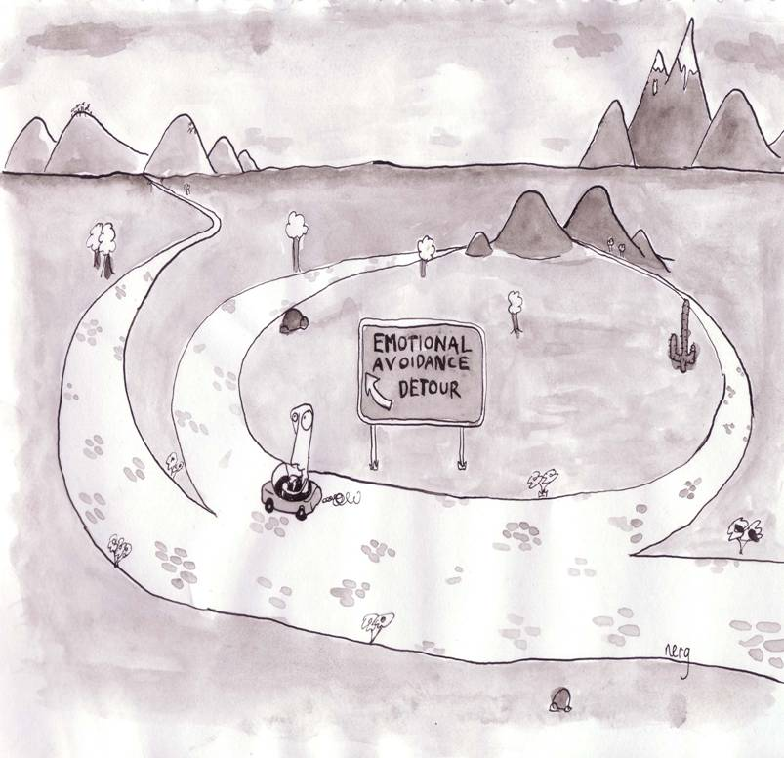
Flexibility
Rigidity
RFT for clinical use

Slide 8
Flexibility:
Psychological flexibility is the ability to notice and react to your
thoughts, feelings, and behaviour in order to give one the
opportunity to take action towards important ends.
More specifically this involves responding to one's own responding
as participating in a frame of hierarchy with the deictic “I.” This is
typically accompanied by a substantial reduction in the behavioural
control functions of the response in question, which thereby allows
for additional relational responding that specifies appetitive
augmental functions, and further behaviour that is coordinated
with that relational responding
Notes:
Exemplify: “I can not do this”
Tacting your own behavior

Slide 9
Three clinical tasks
Help the client discriminate the relationship between current functional classes of behaviour and problematic consequences. According to the analysis done we expect the problematic functional class to be responding in coordination with self-instructions/rules.
Help the client discriminate his/her own responses, framing them in perspective and hierarchy with the deictic I. Train this repertoire as an alternative functional class.
Help the client develop this alternative strategy to specify appetitive augmental functions for further behaviour

Slide 10
Tools for therapy
Functional analysis is at the root of ACT
Metaphor
Experiential excercises
Notes:
First FA
Why metaphor??
Quick contact with complex stimulus functions and thus provides a shift of context.
Some defusion
Flexible when functioning as instructions. When following you have to be more experiential. The probability for more contact with direct stimulus functions increase.
Why experiential excercises?
Experiential excercises as analogues of the two classes of behavior that are in focus of therapy
Experiential excercises as part of metaphoric instruction

